Slide 1
CoTMA
St.Mary’s Farm
M Vignesh (2160367),
Trisha Y S (2160467),
Shangumita M (2160451),
Swathy V S (2160453)

Slide 2
INTRODUCTION ABOUT COMMUNITY
St. Mary’s Farm is situated in Gonipura Village in Kumbalgodu-Gollahally , Kengeri Hobli, Bangalore South Taluk. The main crops are coconut, ragi, plantain, etc. It has a well-developed dairy farm. Devadan Farm extends with coconut trees, fodder grass, mango groves and other fruit trees. The property is situated along the main road of Bangalore-Mysore state highway.

Slide 3
ABSTRACT
The St. Mary's Farm Project represents a pioneering initiative aimed at revolutionizing agricultural practices through the integration of advanced technologies for cow tracking and workers management. This study delves into the multifaceted approach adopted by the project to optimize resource utilization, enhance productivity, and ensure sustainable agricultural practices.
Cow tracking is a pivotal component of the project, leveraging cutting-edge GPS and sensor technologies to monitor the location, health, and behavior of each cattle. The implementation of this system has not only facilitated real-time tracking but has also enabled precise data-driven decision-making for livestock management. The utilization of cow tracking has resulted in improved breeding programs, disease prevention, and overall health monitoring.

Slide 4
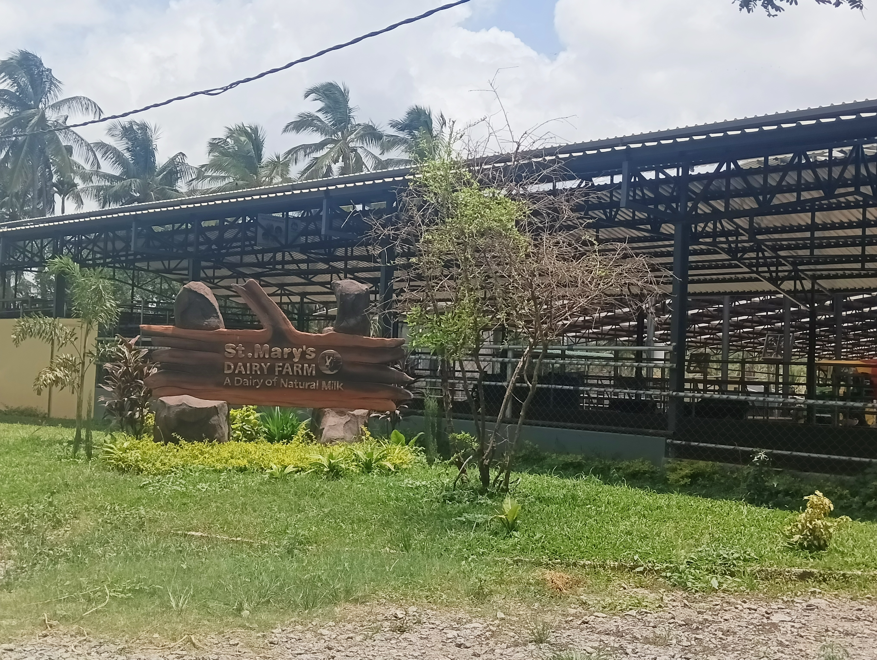
INTRODUCTION
The implementation of cow tracking technologies has emerged as a pivotal strategy within the St. Mary's Farm Project. By tracking the details about the cow such as health, milk production, breeding information, etc, and also about the workers’ management, and their duties. Real-time tracking, health assessments, and behavioral analysis have become integral components of the project's methodology, fostering a data-driven approach to decision-making in livestock husbandry. The resulting precision in managing breeding programs and preventing diseases elevates the cattle's welfare and enhances the farm's overall productivity and sustainability.

Slide 5
PROBLEM STATEMENT
In the context of the St. Mary's Farm Project, several pressing issues have been identified, prompting the need for a comprehensive solution through the implementation of cow tracking and workers management technologies.
Livestock Management Challenges
Labor Allocation and Monitoring Issues

Slide 6
PROPOSED SYSTEM
The proposed system for the St.Mary’s farm is the cow tracking and workers management. The application helps to track the cows health ,number of cows etc in the farm. The proposed workers management system leverages cutting-edge software and IoT devices to optimize human resource allocation and monitoring. A centralized platform will facilitate task assignment, progress tracking, and communication among farm workers.

Slide 7
SOFTWARE AND HARDWARE RECQUIREMETS
Software Requirements:
Database Management System (DBMS):My SQL
Backend Development:
MongoDB
Node.js
Frontend Development:
Web Application: React.js
Version Control:
Git for version control to track changes in the codebase.

Slide 8
Git for version control to track changes in the codebase.
Hardware Requirements:
Application Server: Node.js.
Database Server: Dedicated server or cloud-based instance for the database.

Slide 9
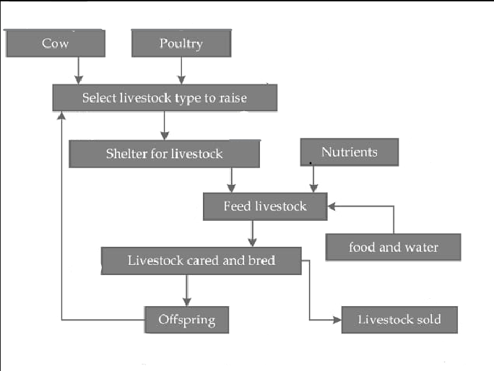
PROPOSED BLOCK DIAGRAM AND ARCHITECTURE
Workers

Slide 10
STATUS OF THE PROJECT
The status of project on St.Mary’s Farm is that the front end for the project is continuing .The front end which include the cow information and workers tracking .The designing of the project is completed. The home page including cow and workers is completed along with the workers tracking page.

Slide 11
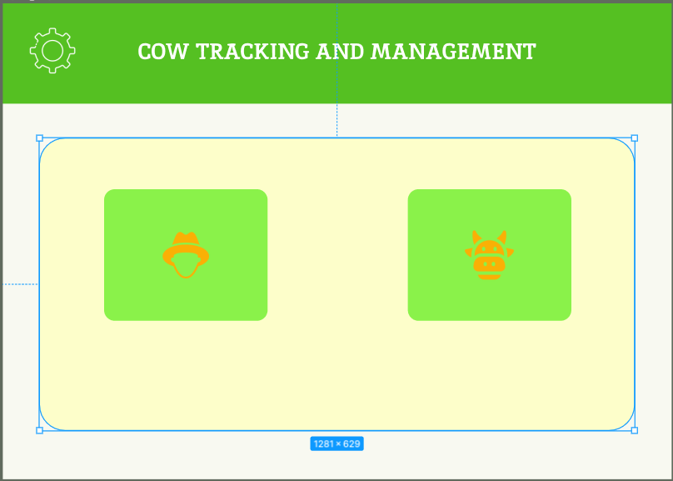
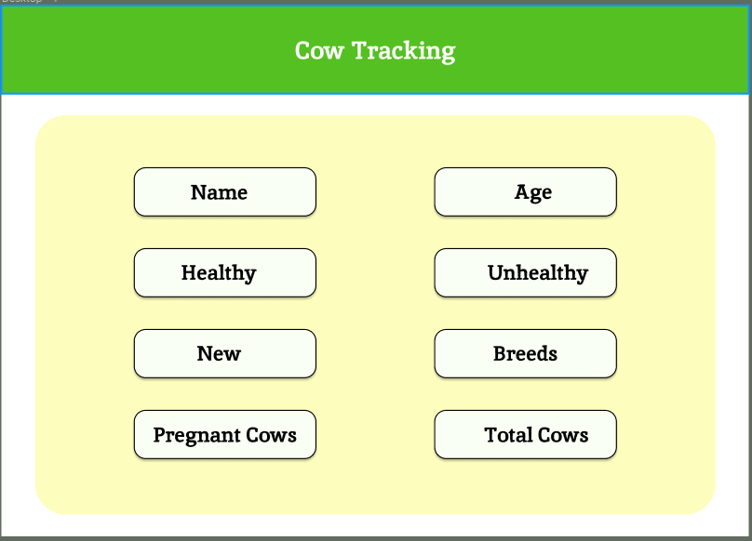

Slide 12
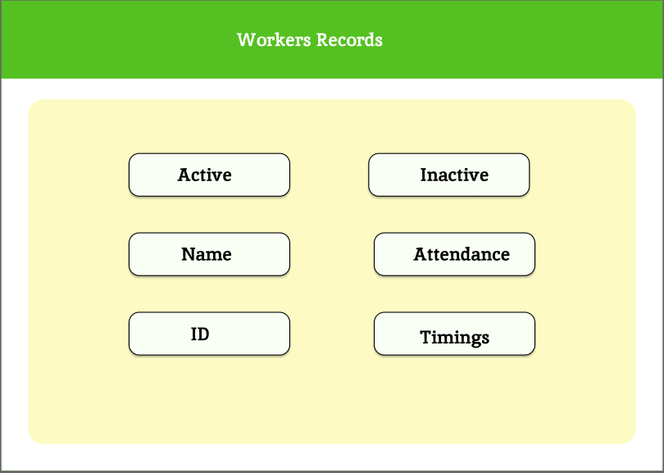

Slide 13
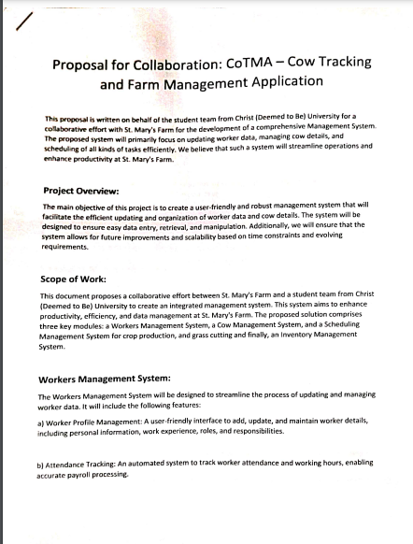
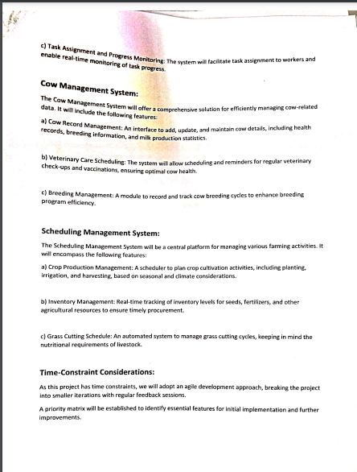
CONFIRMATION LETTER

Slide 14
